Slide 1

Question Bank - Extracting Questions from pdf
CS-490 RnD Project
-Nagendra, 150050067
-Sai Sharath, 150050087

Slide 2
Introduction
Question Bank is a collection of questions from various sources categorised by subject, chapter etc...
Using question bank to automate the task of generating question papers with constraints on chapters/marks saves a lot of manual time.
Obtaining data to populate the question bank is a major hurdle in using it effectively.

Slide 3
Motivation
Manually obtaining questions to fill the question bank can be a very tedious process.
It is desirable to have a tool which can automatically extract questions from question papers.
Question papers available online are found in various formats among which PDF is the most common format.
A tool to extract questions from PDFs can be used for other file formats also by converting them to PDF.

Slide 4
Required Features
Reproducibility of the original PDF including metadata such as font types, style etc…
Intelligent detection of questions and storing the extracted questions in a consistent format.
Extracting images of various formats and associating each image with corresponding question.
Ability to adjust the automatic splitting of questions.

Slide 5
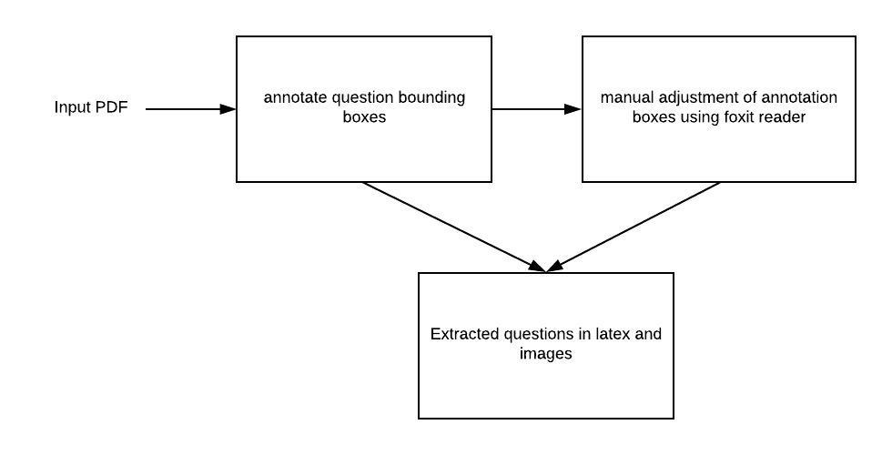
Architecture

Slide 6
Implemented Features
Automatic splitting of questions based on certain common regex patterns.
Along with text extraction all the images in an annotation box are extracted and associated with the question.
The converted latex format captures metadata such as font style and special characters.

Slide 7
Technical Details
Programming Language: python2
Libraries
pdfminer
Extracting text from PDF, splitting into questions based on layout analysis
font styles and images and their locations
PyPDF2
Creating annotation boxes and analysing them from an annotated pdf
supplement image data
pdf2image
Extracting a small area of pdf page as image
pylatexenc
latex encoding of unicode characters
PIL/Pillow
Reading and saving images

Slide 8
DEMO

Slide 9
Difficulties and Challenges
Most of the libraries available had little to no documentation and required thorough understanding of the codebase for effective usage.
Coming up with annotations to extract part of PDF, trying to build a visual to integrate with browser were some of the key challenges encountered.
Moreover, there was no single library which worked flawlessly, each library worked only for certain purposes. Some images could only be extracted by pdfminer and some only by PyPDF2, poppler extracted excess blank images.

Slide 10
Future Work
The method employed to split questions automatically is naive and can be improved.
The intermediate tool to adjust annotations is not integrated with browser.
The current tool itself is not integrated with question bank.
Extracting formulas into latex is still under research. We proposed to solve it by cropping the formula as an image.

Slide 11
Conclusion
Working with PDFs can be quite difficult. Most of the open source libraries aren’t well documented and do not work under all circumstances.
Moreover, each library provides only certain functionalities. Building a tool to extract data from PDFs often requires the usage of multiple libraries.

Slide 12
THANK YOU

